Slide 1
What is Web?
World Wide Web (WWW)
Created by Tim Berners-Lee
A type of internet services
Examples of internet services: Telnet, FTP, HTTP
웹이란?
HTTP를 이용하는 인터페이스
인터넷에 연결된 컴퓨터를 통해 사람들이 정보를 공유할 수 있는 전 세계적인 정보 공간

Slide 2
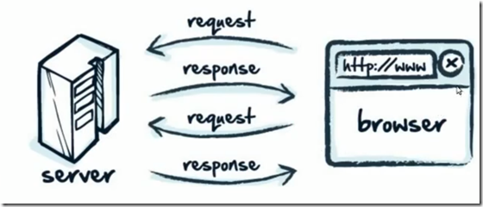
What is a web server?
It is a computer connected to Internet that waits requests from a browser.

Slide 3
What is a web browser?
It is a software application for accessing information on the World Wide Web.
When a user requests a web page from a particular website, the web browser retrieves the necessary content from a web server and then displays the page on the user's device.

Slide 4
What is HTML?
Hypertext Markup Language (HTML)
It is the standard markup language for documents designed to be displayed in a web browser.
It can be assisted by technologies such as Cascading Style Sheets (CSS) and scripting languages such as JavaScript.

Slide 5
What is CSS?
Cascading Style Sheet (CSS)
It is a style sheet language used for describing the presentation of a document written in a markup language like HTML.
Ex) font, color, spacing…

Slide 6
What is JavaScript?
It is an object-oriented computer programming language commonly used to create interactive effects within web browsers.
It is initially created to “make web pages alive”.

Slide 7
What is PHP?
Hypertext Preprocessor (Initially, Personal Home Page Tools)
It is a general-purpose scripting language that is especially suited to web development.
It is a server-side scripting language to develop static websites or dynamic websites or Web applications

Slide 8
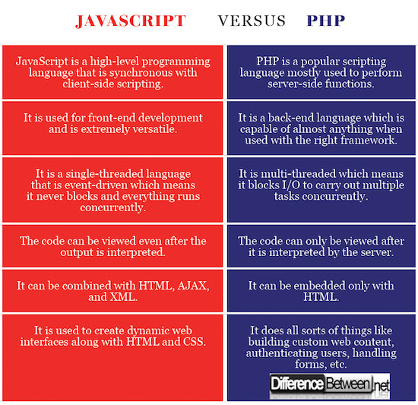

Slide 10
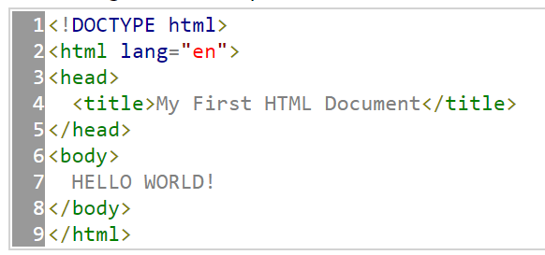
1. HTML5
Basic HTML Structure

Slide 11
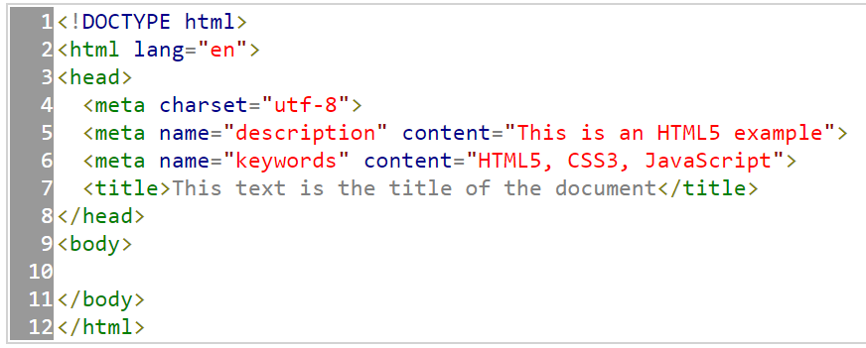
1. HTML5
Basic HTML + Title & Metadata

Slide 12
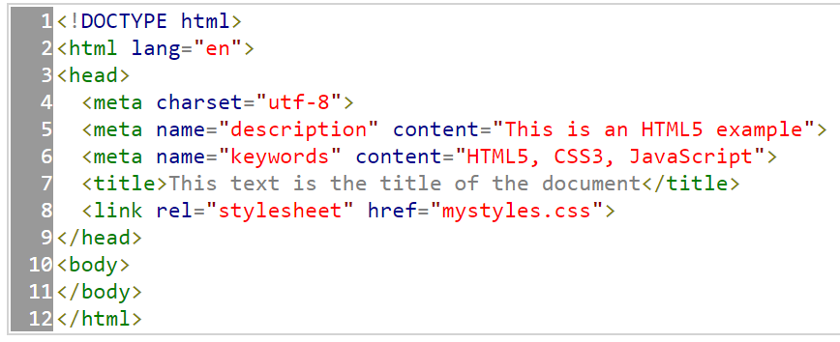
1. HTML5
Basic HTML + Title & Metadata + Link

Slide 13
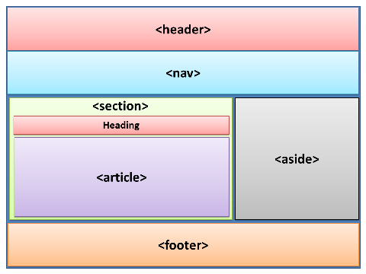
1. HTML5
Standard webpage layout

Slide 14
1. HTML5
Standard webpage layout
Header: Head for the body section
<header>
<h1> This is the main title of the website </h1>
</header>

Slide 15
1. HTML5
Standard webpage layout
Navigation bar: Menu option of a webpage
<nav>
<li> home </li>
<li> photos </li>
<li> videos </li>
<li> contact </li>
</nav>

Slide 16
1. HTML5
Standard webpage layout
Section: Main information. It can be divided into multiple section
<section>
</section>

Slide 17
1. HTML5
Standard webpage layout
Sidebar: Next to Section, less important information
<aside>
<blockquote> Quotation from article #1</blockquote>
<blockquote> Quotation from article #2</blockquote>
</aside>

Slide 18
1. HTML5
Standard webpage layout
Footer: Located at the end of a webpage
<footer>
Copyright &copy; 2014
</footer>

Slide 19
1. HTML5
Standard webpage layout
Article: the core content
<article>
This is the text of my first post
</article>
<article>
This is the text of my second post
</article>

Slide 20
1. HTML5
Standard webpage layout
hgroup: head tag group
<hgroup>
<h1> Title of post one </h1>
<h2> Subtitle of the post one </h2>
</hgroup>

Slide 21
1. HTML5
Standard webpage layout
figure와 figcaption: Content (Image, Video)
<figure>
<img src=http://minbooks.com/content/myimage.jpg>
<figcaption> This is the image of the first post </figcaption>
</figure>

Slide 22
HTML: Basic Tags
What is HTML tag?
HTML tags are the hidden keywords within a web page that define how your web browser must format and display the content.
Most tags must have two parts, an opening and a closing part.
For example, <html> is the opening tag and </html> is the closing tag.

Slide 23
HTML: Basic Tags
Basic tags
<html> ~ </html>: Indicates the beginning and the ending of a HTML document
<head> ~ </head>: Handles the metadata of a HTML documents
<body> ~ </body>: Has everything that has to do with the presentation of a HTML document

Slide 24
HTML: Basic Tags
<html>
<head>
(Metadata of the HTML document)
</head>
<body>
(Presenation/functions of the document)
</body>
</html>

Slide 25
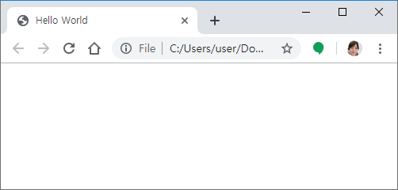
HTML: Basic Tags - Title
<html>
<head>
<title> Hello World </title>
</head>
<body>
</body>
</html>

Slide 26
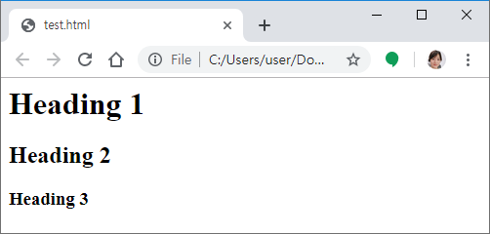
HTML: Basic Tags - Heading
<html>
<head>
</head>
<body>
<h1> Heading 1 </h1>
<h2> Heading 2 </h2>
<h3> Heading 3 </h3>
</body>
</html>

Slide 27
HTML: Basic Tags - Font
<b>: Bolded text
<html>
<head>
</head>
<body>
Hi. My name is <b> Uran Oh </b>.
</body>
</html>

Slide 28
HTML: Basic Tags - Font
<i>: Italics
<html>
<head>
</head>
<body>
Hi. My name is <i> Uran Oh </i>.
</body>
</html>

Slide 29
HTML: Basic Tags - Font
<u>: underline
<html>
<head>
</head>
<body>
Hi. My name is <u> Uran Oh </u>.
</body>
</html>

Slide 30
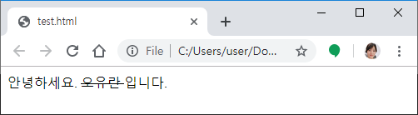
HTML: Basic Tags - Font
<del>: cancel
<html>
<head>
</head>
<body>
안녕하세요. <del> 오유란 </del> 입니다.
</body>
</html>

Slide 31
HTML: Basic Tags - Font
<mark>: highlight<html>
<head>
</head>
<body>
Hi. My name is <mark> Uran Oh </mark>.
</body>
</html>

Slide 32
HTML: Basic Tags - Font
<sub>: Text_{subscript}
<html>
<head>
</head>
<body>
Water is H<sub>2</sub>O.
</body>
</html>

Slide 33
HTML: Basic Tags - Font
<sub>: Text^{superscript}
<html>
<head>
</head>
<body>
2<sup>3</sup> = 8
</body>
</html>

Slide 34
HTML: Basic Tags - Font
<blockquote>: “quotes"
<html>
<head>
</head>
<body>
She said, <blockquote>Hi. My name is Uran Oh</blockquote>
</body>
</html>

Slide 35
HTML: Basic Tags - Font
<marquee>: moving characters from right to left
<html>
<head>
</head>
<body>
<marquee>Hi. My name is Uran Oh</marquee>
</body>
</html>

Slide 36
HTML: Basic Tags - Paragraph
<p>: Make a new paragraph
<html>
<head>
</head>
<body>
She said, <p>Hi. My name is Uran Oh
</body>
</html>

Slide 37
HTML: Basic Tags - Paragraph
<br>: Make a new line
<html>
<head>
</head>
<body>
She said, <br>Hi. My name is Uran Oh
</body>
</html>

Slide 38
HTML: Basic Tags - Paragraph
&nbsp: Spaces between characters
<html>
<head>
</head>
<body>
Hi. &nbsp My name is Uran Oh
</body>
</html>

Slide 39
HTML: Basic Tags - Paragraph
<p align>: Paragrach Alignment
<html>
<head>
</head>
<body>
<p align = “left”> Left </p>
<p align = “right”> Right </p>
<p align = “center”> Centered </p>
<p align = “justify”> Justified </p>
</body>
</html>

Slide 40
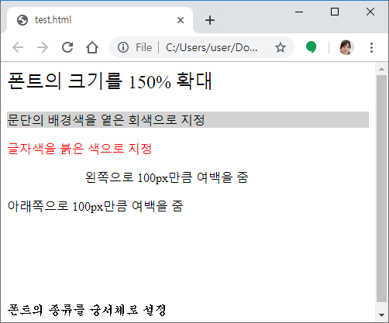
HTML: Basic Tags - Paragraph
<p style>: Pragraph Stype
<html>
<head>
</head>
<body>
<p style = “font-size:150%”> 폰트의 크기를 150% 확대</p>
<p style = “background-color:lightgray”> 문단의 배경색을 옅은 회색으로 지정 </p>
<p style = “color:red”> 글자색을 붉은 색으로 지정 </p>
<p style = “padding-left:100px”> 왼쪽으로 100px만큼 여백을 줌</p>
<p style = “padding-bottom:100px”> 아래쪽으로 100px만큼 여백을 줌</p>
<p style = “font-family:궁서”> 폰트의 종류를 궁서체로 설정</p>
</body>
</html>

Slide 41
HTML: Basic Tags - List
<ol>: Ordered list
<html>
<head>
</head>
<body>
The most popular movies in 2019<p>
<ol>
<li> Top 1</li>
<li> Top 2 </li>
<li> Top 3 </li>
</ol>
</p>
</body>
</html>

Slide 42
HTML: Basic Tags - List
<ul>: Unordered list
<html>
<head>
</head>
<body>
Examples of programming languages<p>
<ul>
<li> C</li>
<li> C++ </li>
<li> Python </li>
</ul>
</p>
</body>
</html>

Slide 43
HTML: Basic Tags - List
Using nested lists
<html>
<head>
</head>
<body>
<ol>
<li> Item 1 </li>
<ul>
<li> C</li>
<li> C++ </li>
</ul>
<li> Item 2 </li>
</ol>
</body>
</html>

Slide 44
HTML: Basic Tags - Image
Types of Images
JPG(JPEG, Joint Photographic coding Experts Group)
Has a good compression rate
GIF(Graphics Interchange Format)
Use 256 colors to reduce the size of an image
PNG(Portable Network Graphics)
Use 256 colors + alpha (transparency)
Slightly heavier than JPG, but Less loss of image quality

Slide 45
HTML: Basic Tags - Image
Image Address
Absolute address
<img src = “https://i.kinja-img.com/gawker-media/image/upload/s--UYWnBrHt--/c_scale,f_auto,fl_progressive,q_80,w_800/wmpvownqus8xwvylswsr.jpg”>
<img src = “D:\users\images\cat.jpg”>

Slide 46
HTML: Basic Tags - Image
Image Address
Relative address
If the image file is located at the same directory as the html file
<img src = “cat.jpg”>
Lower directory case
<img src = “images\cat.jpg”>
Upper directory case
<img src = “..\cat.jpg”>

Slide 47
HTML: Basic Tags - Image
Inserting an image
<html>
<head>
</head>
<body>
<img src = “images/cat.jpg”>
</body>
</html>

Slide 48
HTML: Basic Tags - Image
Setting the size: width & height
<html>
<head>
</head>
<body>
<img src = “images/cat.jpg” width = “300“ height = “300”>
</body>
</html>

Slide 49
HTML: Basic Tags - Image
Image alignment
<html>
<head>
</head>
<body>
<img src = “images/cat.jpg” width = “300“ height = “300” align = “left”>
</body>
</html>

Slide 50
HTML: Basic Tags - Image
Image border
<html>
<head>
</head>
<body>
<img src = “images/cat.jpg” width = “300“ height = “300” align = “left” border = “5”>
</body>
</html>

Slide 51
Agenda
Intro to HTML
HTML: Basic Structure
HTML: Basic tags
HTML: Advanced tags
HTML: Practice

Slide 52
HTML: Advanced Tags - Table
<table> : table tag
colspan, rowspan, border, bgcolor, width, height, cellpadding, cellspacing, align, valign
<tr> : table row, makes a row
<td> : table data, makes a cell
<th> : table head, makes a title of a table

Slide 53
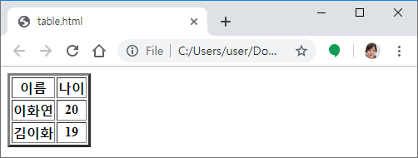
HTML: Advanced Tags - Table
<html>
<head>
</head>
<body>
<table border =“3”>
<tr> <th> 이름 </th> <th> 나이 </th> </tr>
<tr> <th> 이화연 </th> <th> 20 </th> </tr>
<tr> <th> 김이화 </th> <th> 19 </th> </tr>
</table>
</body>
</html>

Slide 54
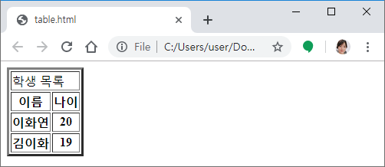
HTML: Advanced Tags - Table
<html>
<head>
</head>
<body>
<table border =“3”>
<tr> <td colspan = “2”> 학생 목록 </td> </tr>
<tr> <th> 이름 </th> <th> 나이 </th> </tr>
<tr> <th> 이화연 </th> <th> 20 </th> </tr>
<tr> <th> 김이화 </th> <th> 19 </th> </tr>
</table>
</body>
</html>

Slide 55
HTML: Advanced Tags - Table
<html>
<head>
</head>
<body>
<table border =“3”>
<tr> <td rowspan = “3”> 학생 목록 </td> </tr>
<tr> <th> 이름 </th> <th> 나이 </th> </tr>
<tr> <th> 이화연 </th> <th> 20 </th> </tr>
<tr> <th> 김이화 </th> <th> 19 </th> </tr>
</table>
</body>
</html>

Slide 56
HTML: Advanced Tags - Table
<html>
<head>
</head>
<body>
<table cellspacing = “10” cellpadding = “10” border =“3” width=“200” height = “200”>
<tr height = “20”>
<td width = “50”> East </td>
<td width = “100”> West </td> </tr>
<tr height = “50”>
<td> South </td>
<td> North </td> </tr>
</table>
</body>
</html>

Slide 57
HTML: Advanced Tags - Table
<html>
<head>
</head>
<body>
<table cellspacing = “10” cellpadding = “10” border =“3” width=“200” height = “200”>
</table>
</body>
</html>

Slide 58
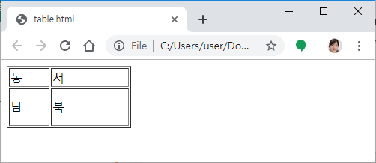
HTML: Advanced Tags - Table
<html>
<head>
</head>
<body>
<table border = "1">
<tr height = "20">
<td width = "50"> 동 </td> <td width = "100"> 서 </td> </tr>
<tr height = "50">
<td> 남 </td> <td> 북 </td> </tr>
</table>
</body>
</html>

Slide 59
HTML: Advanced Tags - Link
<a>: Anchor, link
External link
<a href=http://www.uranoh.com/> Uran Oh’s homepage </a>
Internal link
<a href=“#id“>name of the link</a>
<a name=“id”></a>

Slide 60
HTML: Advanced Tags - Link
<html>
<head> </head>
<body>
<a href=“#bottom“ name=“top”>Look down</a>
<p style = “height:1000px”> ….. </p>
<a name=“bottom” href=“#top”>:P</a>
</body>
</html>

Slide 61
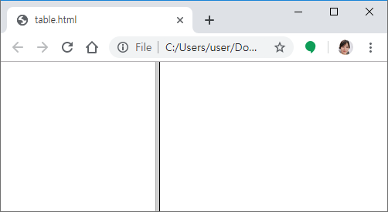
HTML: Advanced Tags - Frame
Frame: Indicating boundaries within a window of a web browser.
<head>
<frameset cols = “200, *”>
<frame src =“”>
<frame src = “”>
</frameset>
</head>

Slide 62
HTML: Advanced Tags - Frame
Frame: Indicating boundaries within a window of a web browser.
<head>
<frameset cols = “200, *”>
<frame src =“”>
<frame src = “”>
</frameset>
</head>

Slide 63
0. Review – HTML Frame
Frame: Indicating boundaries within a window of a web browser.
<head>
<frameset cols = “200, *”>
<frame src =“address1”>
<frame src = “address2”>
</frameset>
</head>

Slide 64
HTML: Advanced Tags - Form
Form: gets users’ input with a dialog box
method: specifies a communication method
Get: > 1kb data
Post: < 1kb data
action: specifies where to send the collected input
<form method = “get” action = “confirm.php”> </form>

Slide 65
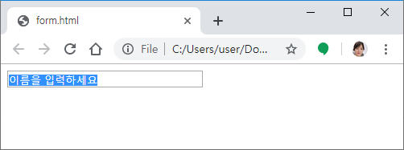
HTML: Advanced Tags - Input
<input>: Basic input type
Text: Entering text
Size: textfield의 길이
Maxlength: 입력할 수 있는 최대 글자수
Value: textfield의 기본값
<html>
<body>
<form method="get" action="">
<input type = "text" name="my_id" size = "30" maxlength ="8" value="이름을 입력하세요">
</form>
</body>
</html>

Slide 66
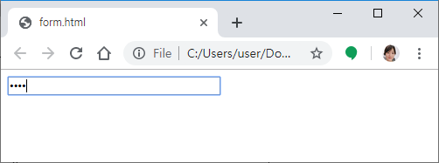
HTML: Advanced Tags - Input
<input>: Basic input type
Password: The same as text but represented with ‘*’ signs
<html>
<body>
<form method="get" action="">
<input type = "password" name="my_password" size = "30" maxlength ="8" value=“1234">
</form>
</body>
</html>

Slide 67
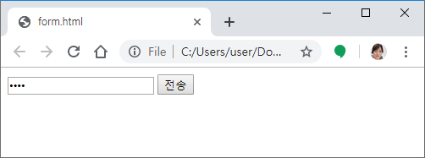
HTML: Advanced Tags - Input
<input>: Basic input type
submit: Send the entered text
<html>
<body>
<form method="get" action="test.html">
<input type = "password" name="my_password" value=“1234">
<input type = "submit" value=전송>
</form>
</body>
</html>

Slide 68
HTML: Advanced Tags - Input
<input>: Basic input type
Image button: a button with an image
<html>
<body>
<form method="get" action="test.html">
<input type = "password" name="my_password" value=“1234">
<input type = "image＂ src= ” [Image Address] ＂ height = " 20 ＂ width = " 30“>
</form>
</body>
</html>

Slide 69
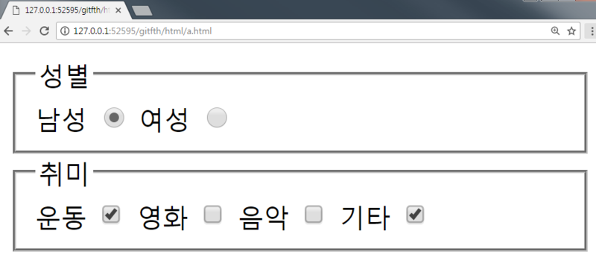
HTML: Advanced Tags - Input
<input>: Basic input type
Text: Entering text
Password: Entering text but as ‘***”
Checkbox:
Radio:
Submit: Send the input entered to a form
Reset: Resets whatever that was entered
Image value: Prints an image

Slide 70
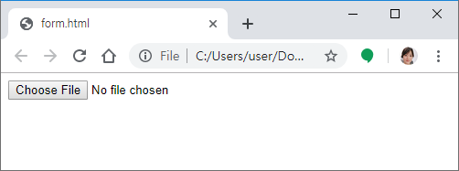
HTML: Advanced Tags - Input
<input>: Basic input type
file: creates a button to attach a file and creates a window for browsing for a file to be attached
<html>
<body>
<form method="get" action="">
<input type = ＂file＂ name = ＂ my_file ＂ >
</form>
</body>
</html>

Slide 71
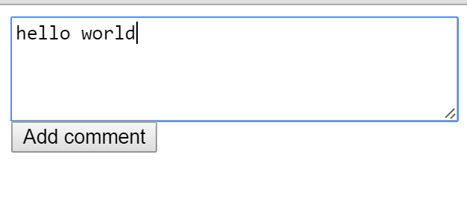
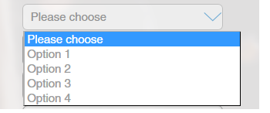
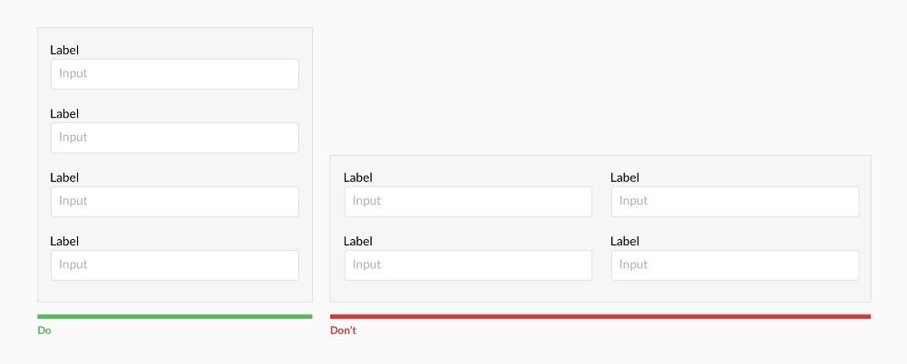
HTML: Advanced Tags - Input
<input>: Basic input type
Textarea
Select box
label

Slide 72
HTML: Advanced Tags - Multimedia
Multimedia: combination of more than 2 types of media
Media: A medium that sends information
Types of media: text, image, audio, video
Types of multimedia:
Audio: MIDI, WAV, MP3
Video: MPEG(MPG), AVI

Slide 73
HTML: Advanced Tags - Multimedia
<embed> : embedding sound or video to a HTML document
Attributes:
Height: Set height
Width: Set width
Autostart: Set the embedded multimedia to start automatically
Loop: Set it to loop or not
Hidden: Hide a player or not
<embed src = “BTS_tour.avi”>

Slide 74
HTML: Advanced Tags - Multimedia
<html>
<head> </head>
<body>
<embed src = “wildlife.avi”>
</body>
</html>

Slide 75
HTML: Advanced Tags - Multimedia
Embedding a YouTube link
<iframe width="420" height="315" src="https://www.youtube.com/embed/tgbNymZ7vqY?autoplay=1"> </iframe>

Slide 76
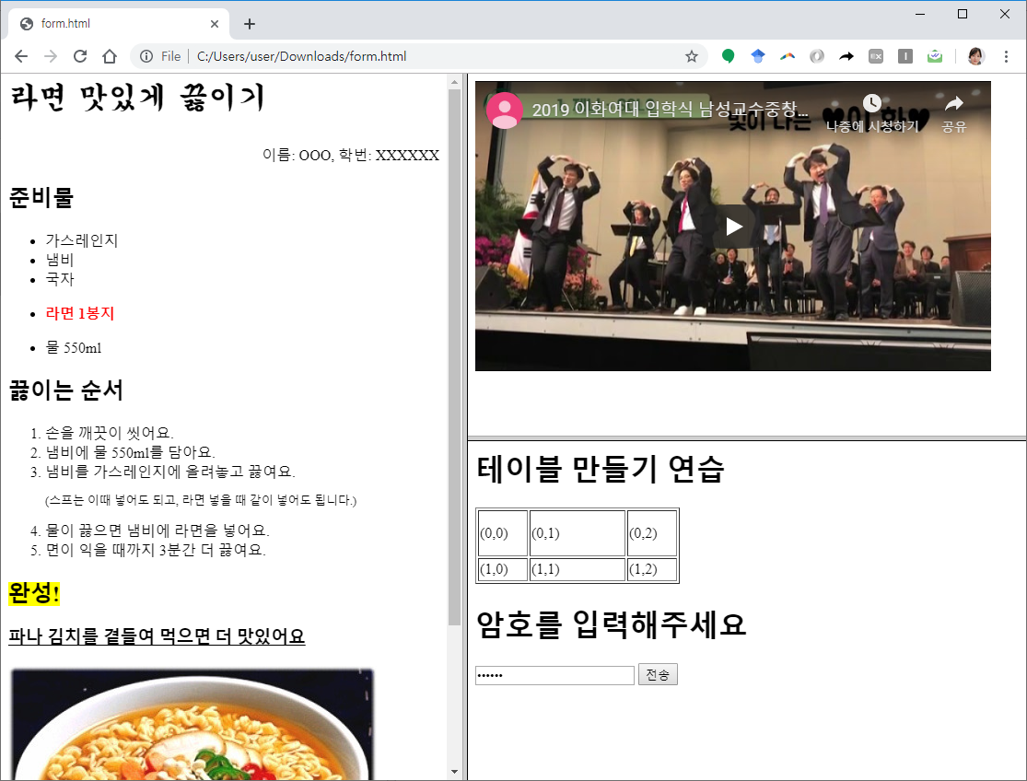
Lab Exercise #2 – Advanced
Make a webpage using frame tags
Need 6 different files Step 4.
bottom: Add a table
Use a form with
Password type
Submit type
Move to submit.html when “submit” button is pressed

Slide 77
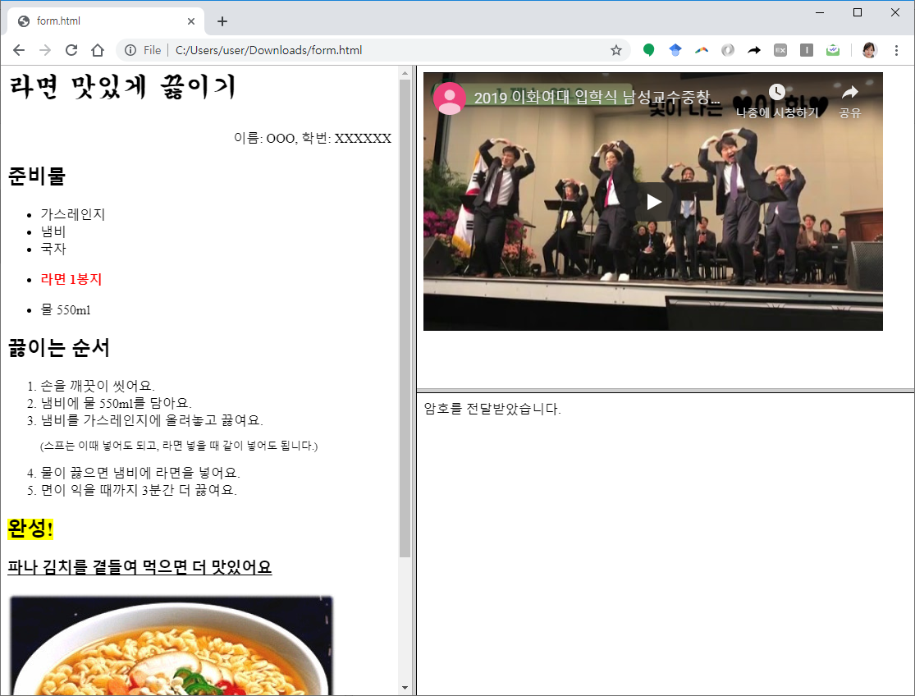
Lab Exercise #2 – Advanced
Make a webpage using frame tags
Need 6 different files Step 5. submit:
Display the following text
“The code has been received”

